Slide 1
Design Notes
Sohan’s Sluts

Slide 2
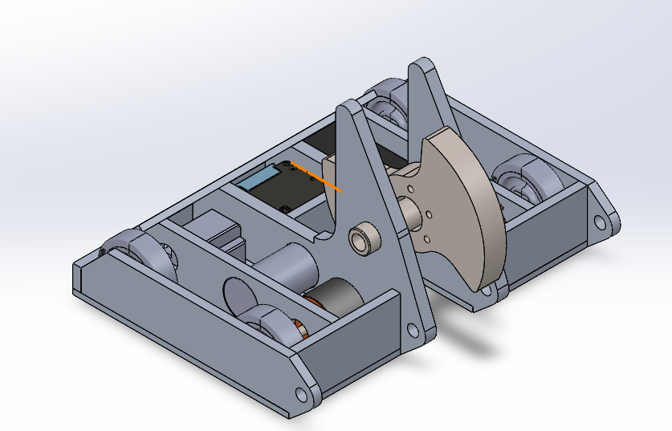
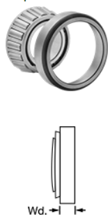
11/13/2022
Weapon Geometry Redo:
Same Dia
Two inch bore
Tapered Roller Bearings
6.04 lbs
Plates we need:
1/8, ¼, 3/8, 1/2,
To do: Back Plate Removal
Wedge Design: need to make progress
Current Weight 24.88 lbs
Need to factor in pulley, shaft, bearings
Update Weights:
Wheels, Battery, Motors

Slide 3
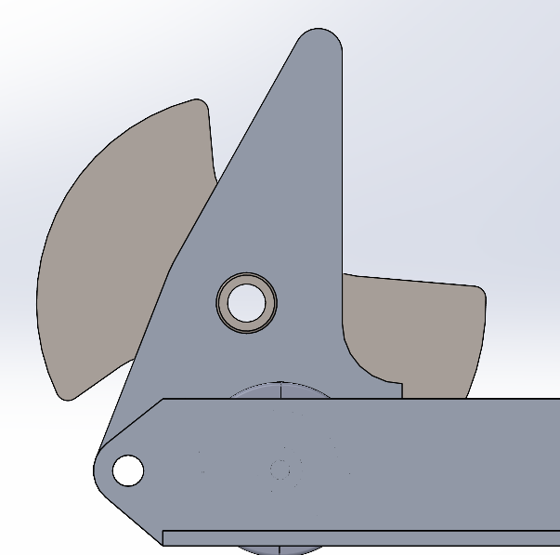
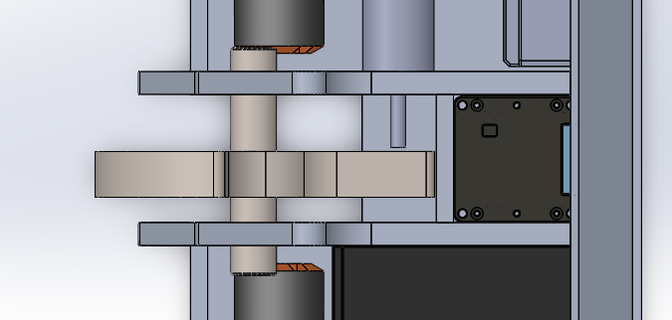
63/64th for roller bearings
Thickness

Slide 4
Task | Sohan | Noah | Tyler | Mattyb | Joshua
Weapon Update? |  |  | X | X | X
Back plate Modifications |  |  | X
Wedge Design |  |  |  | X
Update Weights | X (Make Table)
Figure out AR Plates (Wedge and Weapon) | X |  |  | X
Place encoders in |  |  |  | X
Motor modifications |  |  | X

